Slide 1
Signal Team Four
The best team

Slide 2
Story
Single player blackjack game
Tracks score between games

Slide 3
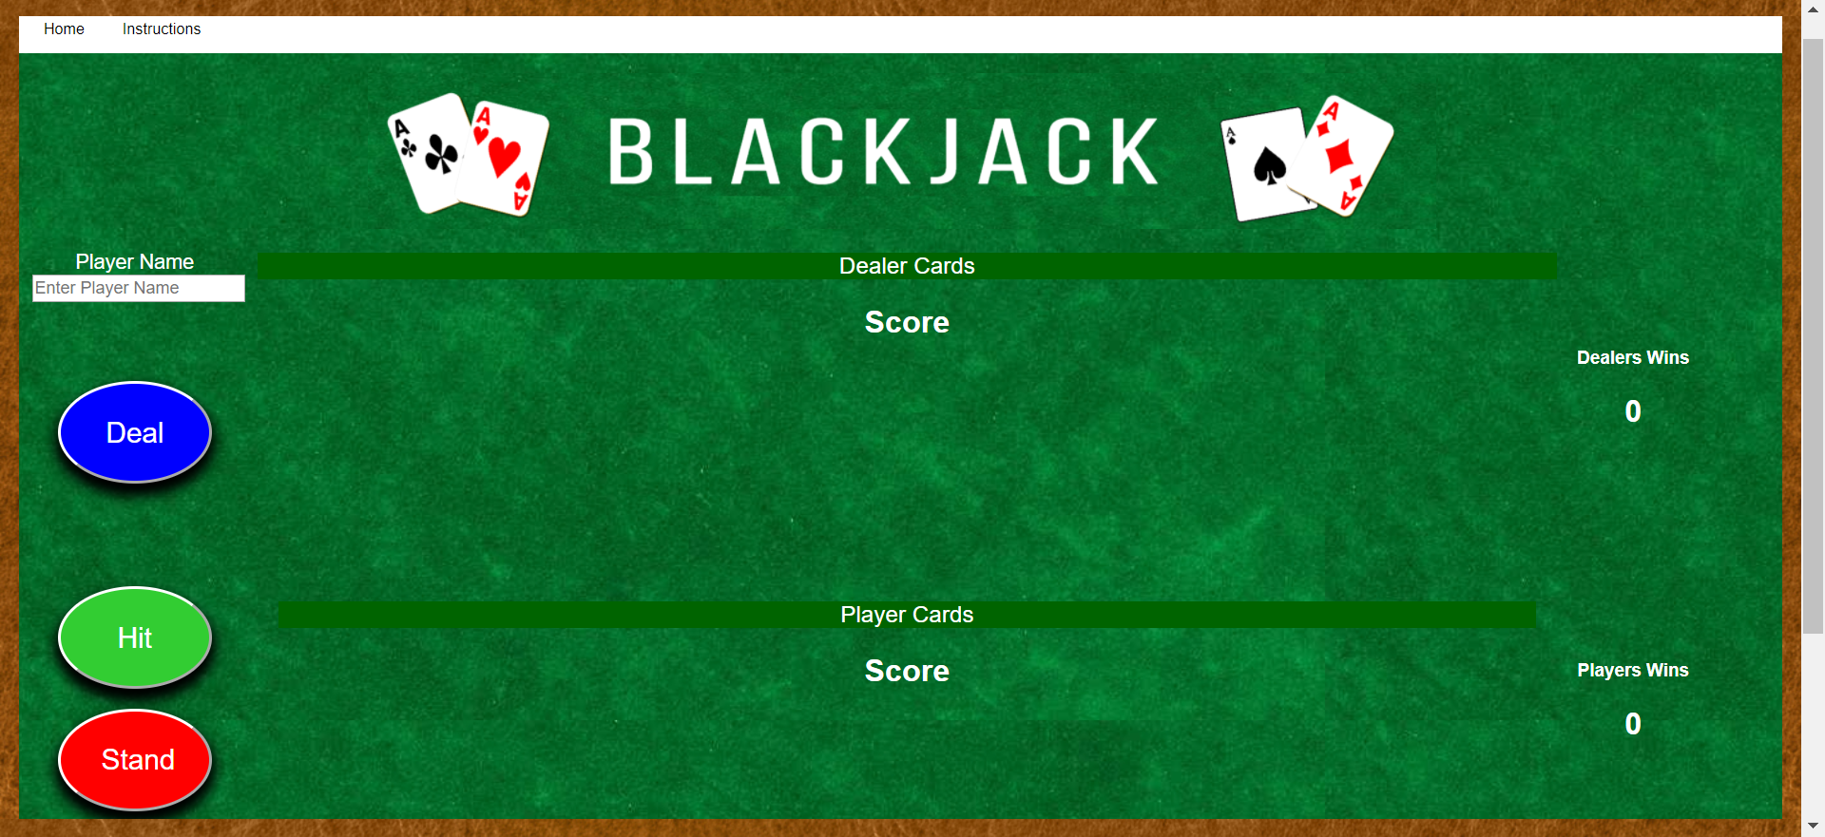
UI/Design

Slide 4
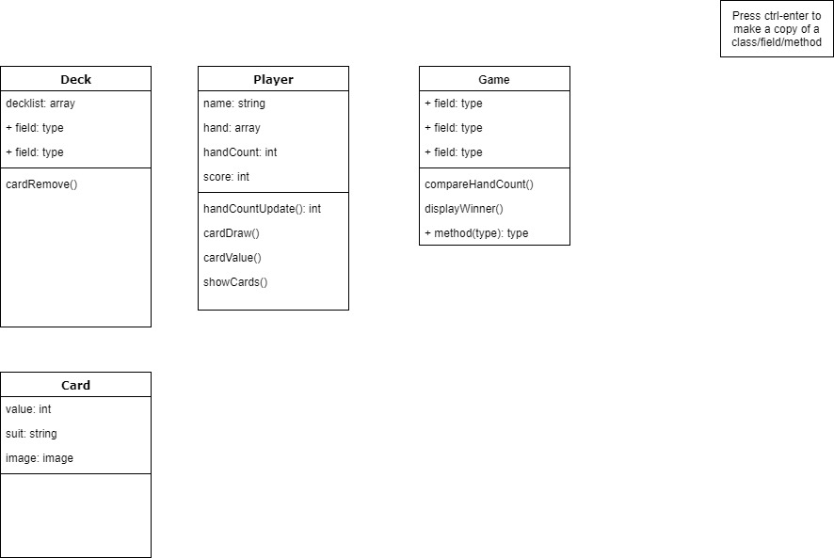
Class diagram

Slide 5
Functionality
Code

Slide 6
The Journey
Learning while working
Working together
Task measuring
Hindsight

Slide 7
Demo

